Slide 1

Codergirl – WebDev Unit
Class 5
August 31st, 2020

Slide 2
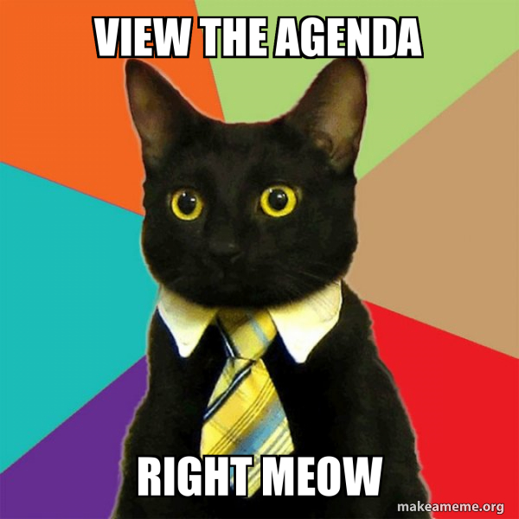

Agenda
Studio Review
Housekeeping
Review
Livecoding
Groups
  Studio

Slide 3
Studio Review

Slide 4
Housekeeping
Studio Reviews
  Which do you prefer?
Graded Assignment #1
  DUE BEFORE CLASS WEDNESDAY

Slide 5
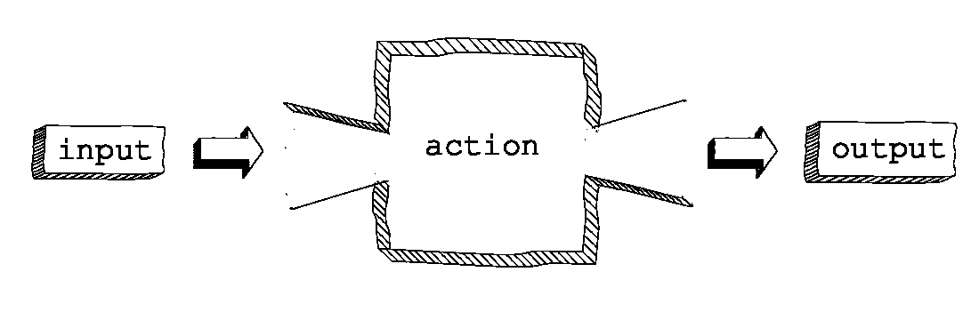
Review - Functions
Reusable piece of code
“Should do exactly one thing.”
Function Machine

Slide 6
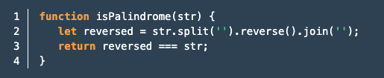
Review – Parts of a Function
Name
Parameters
Return

Slide 7
Review – Naming functions
camelCase
  buildRocketShip() – Good
  build_rocket_ship() – Bad
User verb/noun pairs
  getGamesPlayed() – Good
  games() – Bad
Be descriptive!
  updateUserDatabase() – Good
  runUpdate() – Bad

Slide 8
Review – Why use functions?
Reduce Repetition
  We want our code DRY
Increase Readability
Reduce Complexity
More modular/easier to reuse

Slide 9
Review – Functions
Questions?

Slide 10

Live Coding

Slide 11
Graded Assignment #1
Candidate Testing
Ask candidate to enter their name
Use a loop to ask 5 questions
Check answers for accuracy
Calculate and display results
Do each part in order
How do you eat an elephant?
Due: September 2nd (this Wednesday)

Slide 12
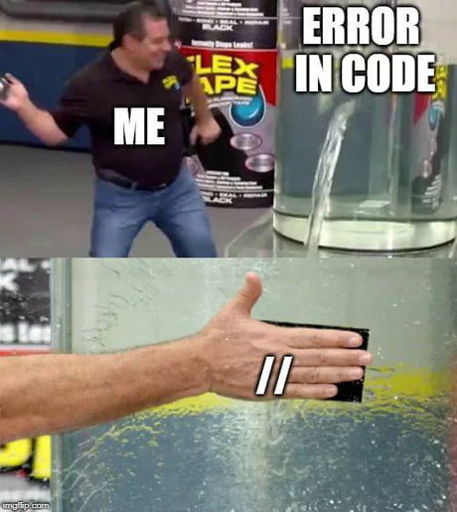
Now
Find your group Zoom
  Studio
  Graded Assignment
  Prep for next week

